Slide 1
Historical Interpretation: An Instructional Model for Gifted Students in the Middle Grades
Meg Hoffman, M.A. Ed.
National Curriculum Networking Conference
2011
Notes:
Thanks so much for coming to the session today! It’s good to see so many of you here- in a conference with a theme of 21st century skills, I wasn’t sure if anyone would want to hear about how to help students dive into the past, but I hope to show how the process of creating and delivering a historical performance will help students develop those 21st century skills they’ll need as they grow and tackle the challenges of the future.
I’ll be talking about historical interpretation – also referred to as historical performance– I tend to use the two interchangeably
Old Notes:
I conducted a literature review that explored various aspects of history instruction in light the needs and abilities of gifted students and came up with an instructional model for using historical interpretation with gifted kids in the middle grades (4-8).

Slide 2
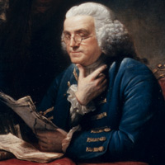
welcome & agenda
What is Historical Interpretation?
Why is it appropriate for gifted learners?
How can it be implemented in the classroom?
Notes:
Mention that there are no handouts, but the powerpoint, as well as all the resources I mention / share are on my website, which will be up at the end. (www.meghoffman.com)
I want you to feel very comfortable – if you need to get up and walk around, leave to take a break, or if you have questions or comments in the middle of the presentation, please don’t hesitate.

Slide 3
First, a question or two. . .
What’s your name?
Where / what do you teach?
Have you used (or seen anyone else use) drama methods (acting, costumes, props, etc.) in Social Studies?
Do you think it was successful? What did the students learn?
Notes:
Introduce myself
“I’ve been involved with several curriculum writing efforts in the Center for Gifted Education, mostly with Social Studies”
Have others introduce themselves
Problems we see over and over when people try to do things that look like this . . .
Too shallow (kids don’t have enough information to really do much)
if a script is provided, end up acting out things they don’t really understand
if a script is not provided, end up making stuff up (you shouldn’t use slaves- you should get some machines!)
it could be well researched, but the drama part of the activity is weak– really just an excuse to dress up in a costume

Slide 4
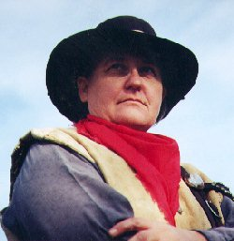
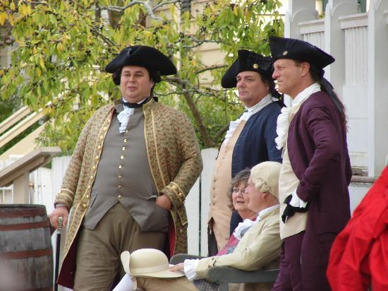
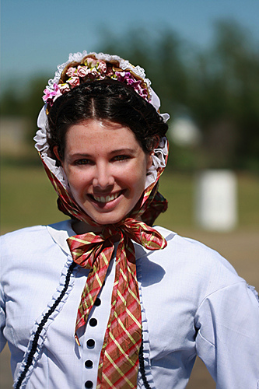
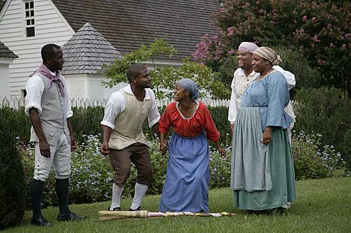
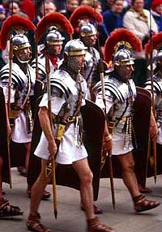
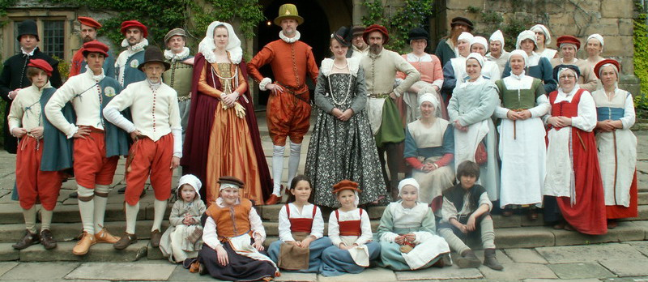
What do we mean by historical interpretation?
Notes:
proceed to the next slide for the definition of HI

Slide 5
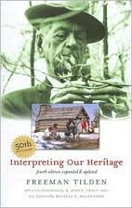
Historical Interpretation
well-researched, historically defensible performance of a historical figure in which the interpreter has the knowledge and performance skills to both give a prepared talk and interact with others while
in character
(Thierer, 2010)
Notes:
-profession with professional standards
Also referred to as historical performance
Many people don’t realize the depth of knowledge that these folks have or the level of research they conduct to be able to convincingly portray a person from history. While researching for an American Revolution curriculum, I talked with several interpreters and was continually impressed with the depth of knowledge that these folks have. (the binder) They have a thorough enough knowledge of the time period and the person they’re interpreting to be able to “be” that person in a way that’s historically responsible (i.e. you can’t just make stuff up- people are relying on you to be an expert.)
I realized as I was talking with these interpreters that this is exactly the kind of depth of knowledge I wanted students to have. I wanted them to understand the people and the societal issues of the era at this level– where they could think about what a person in that time period would logically think, feel, or believe without having their modern day vision in the way.
This is the professional model for what we want kids to do in the classroom when they are using acting in a social studies class
So, we used professional historical interpretation as a framework for designing several activities in the history curriculum we put together and I was so fascinated with the topic that for my thesis, I developed a model that maries the goals and methods of historical interpretation with those of social studies instruction and instruction for gifted learners.
-if we use these professional standards for student projects that involve acting out historical characters or events, we’ve just blown the ceiling off this activity
-similar to many of the projects we have kids do, like role play, biography book report where you dress in character- but reframes it
Will get into more specifics of historical interpretation and some of the keys to the professional methods as they relate to what kids can do in a classroom setting, but if you are interested in learning more about HI as a profession, I would recommend two books: The first is Interpreting Our Heritage, which is on every self-respecting interpreter's shelf. It’s also easy to find used or at a library, because its been around since the 1950’s. If you want a practical guide to historical interpretation, my favorite is Telling History by Joyce Thierer. She talks in it a bit about working with kids, but the great thing about Joyce is that she uses the same methods she outlines for adults with the kids who attend her camps and classroom sessions. The book is easy to read and clear and I think even students could get a lot out of it.
Old Notes:
-This goes beyond acting because of the self-conducted research and the ability to improvise while in character.
-Using Thierer’s Chataqua scholar-performer definition for historical performance (she advocates a change in nomenclature in Telling History)
-continuing the use of the more traditional term historical interpretation because it is still the one most recognizable within the field (National Association for Interpretation uses it, came from Tilden)

Slide 6
Three-Part Model of Historical Interpretation
Hoffman, 2010
Notes:
We’ve talked about historical interpretation as a profession, now I’d like to share with you an instructional model for implementing historical interpretation in the classroom.
The model:
-Historical inquiry, empathy, and drama are all integral to the interpreter’s art. If an interpreter is weak in any of these three areas, her performance will be lacking.
Inquiry: this comes into play mostly with the research part
Empathy: the interpreter has to be able, as much as she can, to see the world as the historical figure saw it and understand their thoughts, decisions, and emotions
Drama: the skills of the actor are the tools an interpreter uses to communicate and to instruct. interpreting with bad acting is like writing a research report with bad grammar.
-By engaging kids in the process of historical interpretation, they will also use the process of inquiry, empathy, and drama.

Slide 7
Definition:
“the process of asking meaningful questions, finding information, drawing conclusions, and reflecting on possible solutions”
(Levstik & Barton, 2001, p.13).
Historical Inquiry
Research Support:
VanSledright, 2002: Upper elementary students learned to formulate questions, search primary and secondary sources for evidence, evaluate the sources for historical merit, and use the information to create a product that expressed their knowledge.
VanSledright, 1995: Students taught with more didactic approaches could not differentiate important concepts from minor details.
Cognitive Processes:
Critical thinking
Analysis
Making connections between disparate data
Abstract thinking
Problem solving
Reasoning
Teaching and Learning Processes:
Forming a research question
Finding, understanding, and evaluating multiple forms of evidence
Acknowledging the inherent bias in all interpretations
Forming evidence-based, tentative conclusions
Notes:
click one: definition
click two: teaching and learning processes
click three: cognitive processes
click four: teaching and learning disappears
click five: research support

Slide 8
Research Support:
Barton & Levstik, 2004: Students seem to have a “default” explanation for puzzling behaviors of people in the past: they were either morally or intellectually inferior to modern people.
Yeager & Doppen, 2001, Barton & Levstik, 2004: Students can, with access to historical evidence and teacher guidance, construct nuanced explanations for the beliefs and actions of people in the past.
Teaching and Learning Processes:
Acquiring contextual knowledge
Finding, understanding, and evaluating multiple forms of historical evidence
Self-examination of perspective
Forming tentative, evidence-based conclusions
Development of caring (about, that, for, to)
Cognitive & Affective Processes:
Learning breadth and depth
Understanding broad concepts / movements / belief systems / forces
Introspection
Problem solving
Critical thinking
Reasoning
Affective engagement
Definition:
perspective recognition (not perspective taking)
Caring about
Caring that
Caring for
Caring to
(Barton & Levstik, 2004)
Historical Empathy
Notes:
click one: definition
click two: teaching and learning processes
click three: cognitive processes
click four: teaching and learning disappears
click five: research support

Slide 9
Research Support:
Gehlbach et al., 2008: Simulation activity increased students’ engagement in perspective recognition.
Alvarez, 2008: High student engagement, learning via self-report data.
DuPont, 2009: Creative dramatics increased students’ reading comprehension by allowing them to explore characters’ points of view.
Teaching and Learning Processes:
Selection of theme / concept / message
Construction of narrative framework
Use and knowledge of documentation
Consideration of the needs / expectations of the audience
Consideration of facial expressions, vocal use, body movements
Use of clothing / material culture / artifacts (real or reproduction) as able
Cognitive & Affective Processes:
Conceptual understanding
Creative thinking and writing
Kinesthetic involvement
Problem solving
Abstract thinking
Drama is used in classroom settings in a variety of ways:
role play
simulation
creative dramatics
process drama
Drama
Notes:
click one: definition
click two: teaching and learning processes
click three: cognitive processes
click four: teaching and learning disappears
click five: research support

Slide 10
Historical Interpretation
Tilden’s (2007) Six Principles :
Relate the performance to the experiences of the audience.
Interpretation is revelation based on information. (Use metaphor, illustration, or whatever it takes to communicate the information rather than burying the audience in facts.)
Interpretation is an art.
The aim of interpretation is to provoke more than it is to instruct.
Use an interpretive performance to communicate a larger concept or message.
Interpretation addressed to children should not simply be a dilution of the program for adults. It should be designed for them specifically (see principle 1).
Chataqua Scholar-In-Role Method:
Monologue
Questions in role
Questions as scholar
Research:
Any volunteers?
Notes:
-This has been around for a long time! Tilden first published Interpreting Our Heritage in 1957. Chataqua started in the late 1800’s, though the scholar-in-role style wasn’t cemented until the revival of the Chataqua movement in the 1970s.
-Scholar-in-role is the method I know of that is being used regularly with students.
-There is no current research on the effectiveness of historical interpretation with students. There is anecdotal evidence (Thierer, numerous practitioner oriented articles) describing positive impacts on students historical knowledge and motivation to learn history

Slide 11
Historical Interpretation and the needs and abilities of gifted adolescents
Curiosity
Concentration in interest area
Ability to learn new information rapidly
Comfort with abstraction
Ability to make connections amongst disparate data
Need for autonomy in a safe space
Ability to learn new information rapidly
Comfort with abstraction
Sensitivity / self-awareness
Emotional intensity
identification with a similar other
Creativity
Comfort with abstraction
Sensitivity / self-awareness

Slide 12
Alignment with Commonly Used Models in Gifted Education
Schoolwide Enrichment Model
Integrated Curriculum Model
Parallel Curriculum Model
Possible Type III activity
Authentic methods
Authentic product
Student-driven
Adaptable to student interests
Advanced content, process, and product
Facilitates both breadth and depth of knowledge
Based in inquiry
Conceptual focus in the building of historical narrative
Interdisciplinary
Parallel of practice (authentic methods, novice to expert continuum)
Easily tailored to student interest and readiness
Interdisciplinary
(Renzulli & Reis, 1997)
(Van Tassel-Baska, 1986)
(Tomlinson et al., 2002)

Slide 13
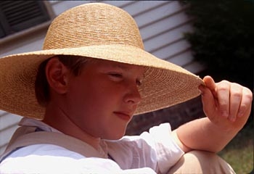
Some examples of how this could work in your classroom . . .
Instructional Activity Ideas:
PBL Scenario: Start your own company!
Junior Interpreter Project
Night at the Museum
Front Lines Scenarios
Progressive Era Interviews
Helpful Resources:
Process packets
Historic Documents
Local Interpreters
Notes:
Junior interpreter project:
-Students create first-person character interpretation for an audition video for a fictional living history program
Front Lines Scenarios:
-Student groups examine a packet of primary source documents related to different aspects of life during the American Revolution (Americans, British, Homefront- including pacifists and spies)
-The group examines the set together
-Each member selects a character and takes one of the historical documents from the set to use to create his/her own character
-The group comes back together to create a scene in which these characters interact
Night At the Museum:
-In an evening program, a docent leads families around a museum
-As the docent stops to highlight an artifact, a person in character discusses the artifact and its significance in his/her life
Resources:
-Kansas Alliance of Historic Performers: Ride into History 22 page packet guiding students through every aspect of the research and character development process. This was developed by the author of Telling History, Joyce Thierer.
-Colonial Williamsburg: Has produced a similar guide, but much shorter- this one includes a rubric
-I would check out both of them and see what looks like it would work for your classroom
-The final suggested resource here is local interpreters- Around here, obviously, we have a lot of experts since Colonial Williamsbug is the largest HI outfit in the country. But if you look around your local area or do a quick search online, you might be surprised at how many experts / potential mentors are near you.

Slide 14
Questions?

Slide 15
All materials from this presentation are available at my website: www.meghoffman.com

Slide 16
Some things to consider when designing curriculum for gifted adolescents:
Cognitive Characteristics
Affective Characteristics & Needs
ability to learn new information rapidly
keen concentration in interest areas
creativity
comfort with abstraction
ability to make connections between seemingly disparate data
(Renzulli, 2009; Van Tassel-Baska, 2003)
heightened sensitivity / self-awareness
emotional intensity
need for intellectual stimulation
need to understand their problems are not unique**
need for a safe space in which to exercise autonomy and develop individual identity*
(Caskey & Anfara, 2007; Robinson, Reis, Neihart & Moon, 2002)
*need exhibited by adolescents **need exhibited by both groups
Notes:
**Warning! there is no such thing as a homogeneous gifted group! BUT we have to start somewhere, and there are some basic characteristics shared by many gifted learners.

Slide 17
Common Themes in Curriculum for Gifted Students
Examined Parallel Curriculum Model, Integrated Curriculum Model, and Schoolwide Enrichment Model
Common themes:
“Real world” or “authentic” issues and problems
“Real world” or “authentic” methodologies
Complex, interdisciplinary learning
Overarching concepts
Emphasis on breadth and/or depth of learning using advanced content
(Renzulli & Reis, 1997; Tomlinson et al., 2002; Van Tassel-Baska, 1986)
Notes:
Common Themes doesn’t nessecarily mean the feature is in all three. Two out of three were sufficient.

Slide 18
Social Studies Curriculum and Instruction: Historical Inquiry
“the process of asking meaningful questions, finding information, drawing conclusions, and reflecting on possible solutions” (Levstik & Barton, 2001, p.13).
Teaching and Learning Processes:
Forming a research question
Finding, understanding, and evaluating multiple forms of evidence
Acknowledging the inherent bias in all interpretations
Forming evidence-based, tentative conclusions
Alignment with gifted education:
Inquiry methods are suggested for use with gifted learners (Van Tassel-Baska & Brown, 2007)
Methods of professional historians (novice to expert continuum)
Depth of study
Critical thinking / problem solving
complexity

Slide 19
Social Studies Curriculum and Instruction: Historical Empathy
Perspective recognition and Caring (about, that, for, to) (Barton & Levstik, 2004).
Teaching and Learning Processes:
Acquiring contextual knowledge
Finding, understanding, and evaluating multiple forms of historical evidence
Self-examination of perspective
Forming tentative, evidence-based conclusions
Development of caring (about, that, for, to)
Alignment with gifted education:
affective engagement
biography study (Hébert & Kent, 2000)
need to understand larger concepts / themes

Slide 20
Classroom Drama
Drama is used in classroom settings in a variety of ways:
role play
simulation
creative dramatics
process drama
Teaching and learning processes:
Selection of theme / concept / message
Construction of narrative framework
Use and knowledge of documentation
Consideration of the needs / expectations of the audience
Consideration of facial expressions, vocal use, body movements
Use of clothing / material culture / artifacts (real or reproduction) as able
Alignment with gifted education:
Engages students creatively
Creative dramatics recommended for use with gifted learners (Johnson, 2000)

Slide 21
Historical Interpretation
Well-researched, historically defensible performance of a historical figure in which the interpreter has the knowledge and performance skills to both give a prepared talk and interact with others while in character (Thierer, 2010)
Chataqua Scholar-In-Role Method:
Monologue
Questions in role
Questions as scholar
Selected Principles from Tilden (2007):
Relate the performance to the experiences of the audience.
Interpretation is revelation based on information. (Use metaphor, illustration, or whatever it takes to communicate the information rather than burying the audience in facts.)
The aim of interpretation is to provoke more than it is to instruct.
Use an interpretive performance to communicate a larger concept or message.
Alignment with gifted education:
professional method
focus on larger concepts / themes
creative process

